Slide 1

Security in Salesforce
How security works behind the scene

Slide 2
Agenda
Org level access
Object Level ( Profile )
Record Level Access
Field Level Access

Slide 3
Organization Level Access
Secure Salesforce Environment

Slide 4
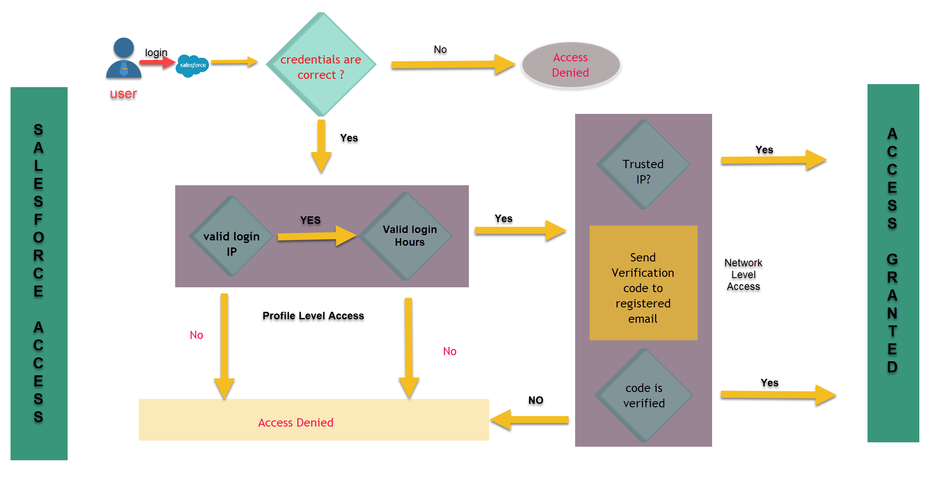

Slide 5

Object Level Access
Who can access the object

Slide 6
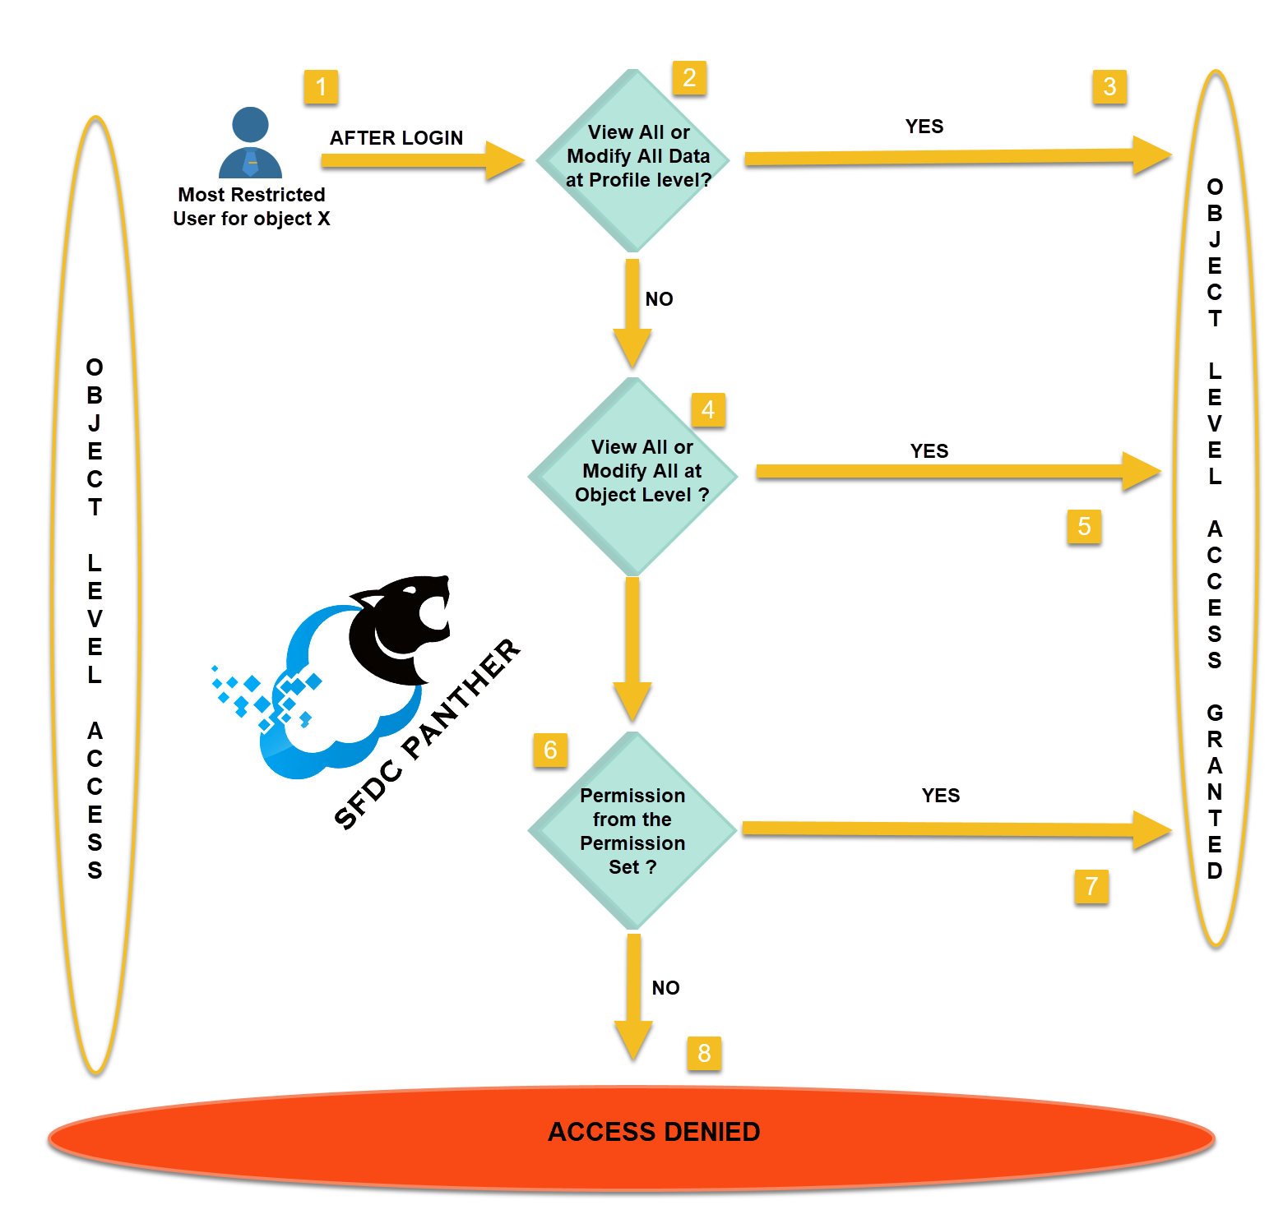

Slide 7


Record Level Access
Anatomy behind the sharing of records

Slide 8
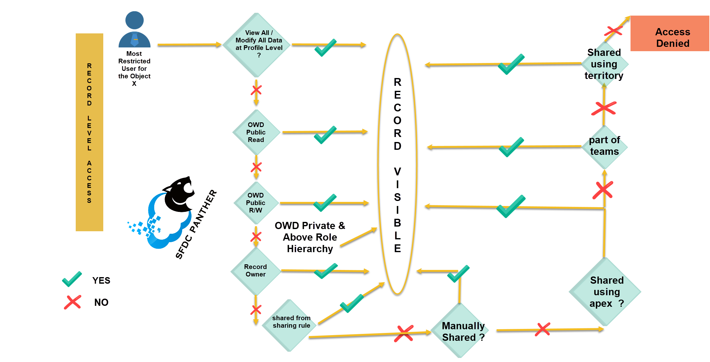

Slide 9

Field Level Access
Access for a particular field

Slide 10
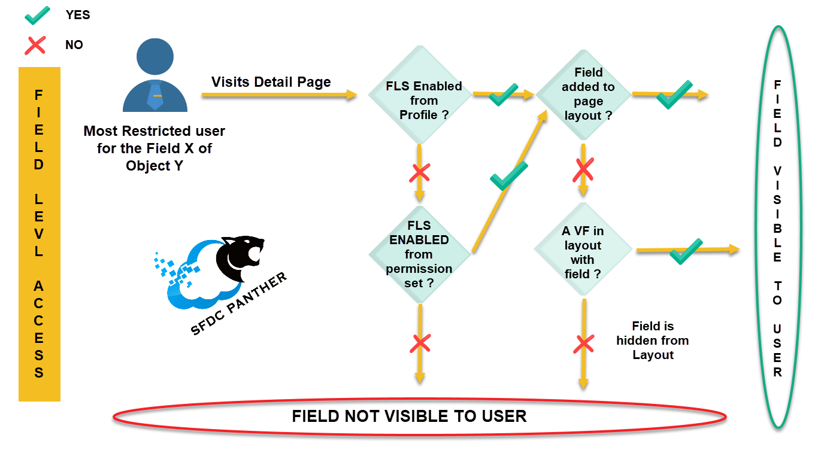

Slide 11

Questions ?

